Slide 1
PKF Private Capital Solutions
© PKF International 2023

Slide 2
PKF Private Capital Solutions
PKF’s Private Capital Solutions practice comprises a team of specialists with a wealth of industry experience based in the major financial centres around the world.
By leveraging the PKF global network, we provide the best possible team for you, drawing on the skills of our 20,000 professionals operating in over 150 countries across our five regions. We have the reach of an international firm balanced with personalised and cost-efficient services.
Our Private Capital Solutions team delivers pragmatic solutions to clients operating in the private capital markets, including private equity, venture capital, private debt, real estate, hedge funds and infrastructure.

Slide 3
PKF Private Capital Solutions
Allocators
Private Foundation
Endowments
Pension Plans
Family Offices
Fund of Funds
High Net Worth
Insurance
Banks / Capital Market
Private Capital markets play a key role in the allocation of institutional investors and, increasingly, retail investors. Assets under management in private assets of USD 16.8tn at the end of 2023
PKF recognizes the importance of reliable and quality professional services for Private Capital markets and has put together a team of specialists in the major financial centres around the world. We define our private capital group to include private equity, venture capital, private debt, real estate, hedge funds, and infrastructure.
PKF
Funds
Private Equity
Venture Capital
Credit
Real Estate
Long/Short
Infrastructure
Fund of Funds

Slide 4
What can we offer you?
We provide strategic and pragmatic advice to benefit your business, tailored to your needs, so that you can focus on what you do best – investing. Our services include:
Core Services
Specialisations
Audit and assurance
Governance, risk management and compliance
M&A advice
Outsourcing
Tax planning, compliance and structuring
Investor reporting
Vendor management
Staffing
Valuation services
ESG reporting
Technology solutions
Cybersecurity, privacy and data protection
Transaction advisory and due diligence

Slide 5
Private Capital Approach
Focus on Profitable Solutions to benefit Private Capital Clients
We provide pragmatic solutions delivered by professionals with deep industry experience in a cost-efficient manner. We leverage the PKF network with its private capital specialists and former industry participants to provide the best possible teams of experts to our clients.

Slide 6
Case Study for a client - Our client’s needs
This leading global investment professional services organization firm with a proven track record in regulated investment management solutions was expanding their operations in the United States, specifically in New York City.
Our client was seeking to work with a firm with international capabilities that could guide them through this new hurdle as they expanded their global footprint. The investment firm was looking for a “one-stop” solution provider at a non-Big Four price point.
The required services included: structural and tax advice & reporting (for both the new firm and its principals), bookkeeping services, and strategic CFO advice.
Mike Stellwagen New York
mstellwagen@pkfod.com

Slide 7
PKF solution and results
PKF invested the time to understand the clients’ needs and challenges. Having the ability to draw from our international network of PKF affiliated member firms, we were able to offer pragmatic solutions for their needs.
PKF has become their trusted valued business advisor providing the following services:
Establishment of transfer pricing policies & procedures;
Tax structuring and return services:
Entity level tax returns;
Establishment of “tax nexus” for foreign Principals;
State and local tax consulting;
Outsourced CFO & Bookkeeping services:
Monthly financial statements;
Bill pay;
Payroll processing;
Strategic oversight.
Ad hoc consulting services as needed.

Slide 8
Case Study for a client - Rockpool Investments
Tom Coey, investment director
“It was a pleasure to work with the highly professional team at PKF on another due diligence engagement. We valued PKF’s commercial input and clear recommendations in what was a thorough and efficient diligence exercise.”
Ben Hutchinson, Investment Director
“PKF added value and insight through their collaborative approach with both of us and the management team, and through their commercial insights which bought the financials to life in clear and focused reports.”
Rockpool Investments is a private equity firm which provides equity and loan financing of between £5 million and £15 million to profitable UK-based companies and has invested more than £650 million since inception in 2012.
We have worked with Rockpool for over three years; providing full suite of corporate finance, tax and compliance services, including
Financial due diligence and buyside advisory
Tax due diligence and structuring
Financial modelling
Debt advisory services to portfolio companies
.

Slide 9
PKF Australia Case Study
US Private Equity Partner
PKF provided transaction and advisory services to a New York based equity partner on the acquisition of several businesses from an Australian publicly listed company.
Objectives: Minimise financial and taxation risks through targeted due diligence procedures Minimise value leakage via purchase price completion adjustment mechanisms Provide clarity regarding working capital requirements and cash burn Advise on deal structure to achieve optimal tax position
Challenges: Australian corporations legislation and listing exchange regulations Navigating global taxation regulations ‘Carve out’ transaction structure of several business units
Solutions: Red flags report to initially identify key financial, taxation and transaction risks to be focused on during a full due diligence phase Helped craft alternative deal structure to mitigate tax risks identified Advised on purchase price completion mechanisms to provide clarity over key items that impacted purchase price Provided specific indirect taxation guidance regarding significant R&D government grant income
At a glance
Sector:
Software & services
Stefan Galbo
Corporate Finance Partner
PKF Australia
sgalbo@pkf.com.au
Services:
Transaction support services
Financial due diligence
Taxation due diligence
“The commitment of the entire PKF deal team to advise and support a US client out of an Australian office on a complex and regulated Australian transaction which required specialist advice across multiple global taxation jurisdictions was only possible by the ability to leverage and collaborate with a flexible team of specialists across the entire PKF global network”
Stefan Galbo
Partner, Corporate Finance
PKF global offices involved:
Australia
USA
Canada
Philippines
Belgium

Slide 10
Case Study for an Emerging Firm
Foundational Phase
Provide strategic assistance with your fund’s launch. Dynamic growth is built on a reliable and scalable operational foundation.
Build operational and financial infrastructure
Finance processes, policies, and procedures (e.g., valuation, financial close)
Cybersecurity processes, policies, and procedures (outsourced CISO)
Governance framework
Regulatory compliance, processes, policies, and procedures (RIA and Fund)
Investor reporting process
Systems selection
Train key personnel
Cybersecurity
Compliance
Finance and tax
Enterprise risk management
Onboarded key staff
Provide pragmatic and knowledgeable observations
Structuring, domicile
Tax planning and compliance
Key staff identification
Selection and onboarding of key 3rd parties
Fund administrator
Auditor
Legal and HR
Banking and custodian
Insurance
Support key initiatives
Audits (e.g., financial, tax, regulatory)
Investor requests
VP Finance
Technology implementation
Growth Phase
Provide strategic assistance with managing volume, complexity, and change in your business.
Evaluate complexity and activity to ensure foundational items noted above are current and appropriate
Assess key staffing needs and training
Continuously evaluate and update key policies and procedures
Keep you abreast of emerging trends and suggested solutions (e.g., accounting, tax, regulatory)
Evaluate and update ESG reporting strategy
Reassess enterprise-wide risks

Slide 11
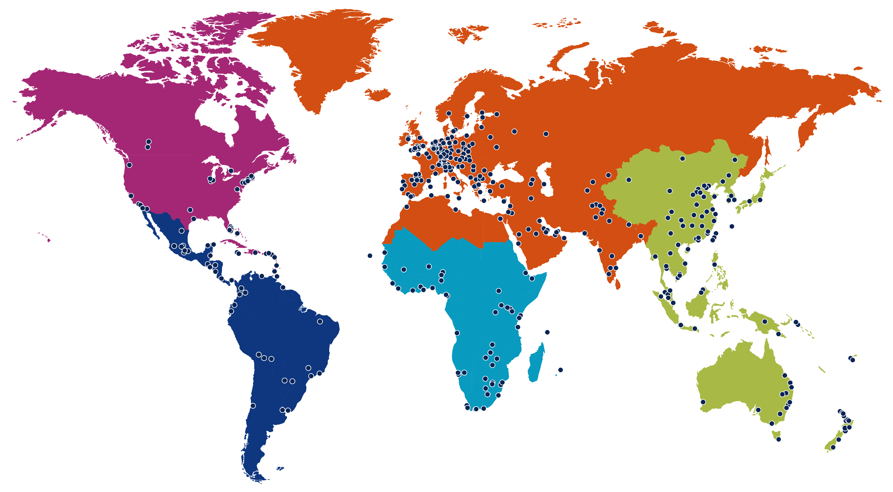
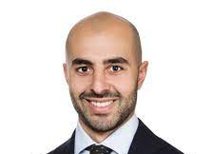
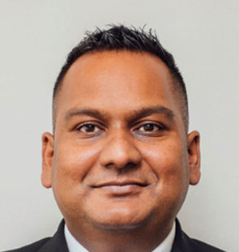
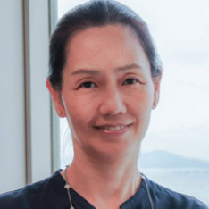
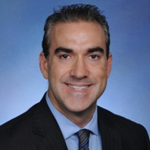
Our people: your team
NORTH AMERICA
EMEI
David E. Kolan Miami
dkolan@bpbcpa.com
Andrew Killick UK
andrew.killick@francisclark.co.uk
Jonathan Moore New Jersey jmoore@pkfod.com
Jean Medernach Luxembourg
jean.medernach@pkf.lu
Mike Hayes New York
mhayes@pkfod.com
Benny Wong UK
bwong@pkf-l.com
ASPAC
Mike Stellwagen New York
mstellwagen@pkfod.com
David-Frédéric Bisseuil France
david-Frederic.bisseuil@pkf-arsilon.com
AFRICA
Stefan Galbo Australia
sgalbo@pkf.com.au
Avishkar Harriparsad avishkar.harriparsad@pkf.co.za
LATAM
Amy Hui Hong Kong
amyhui@pkf-hk.com
Robert C Aldir
Miami
raldir@bpbcpa.com
Ang Kok Keong Singapore
kokkeong.ang@pkf.com

Slide 12
Contact us
Debbie Dell
PKF Private Capital Solutions group co-ordinator
debbie.dell@pkf.com
+44 20 3691 2512
PKF Global
15 Westferry Circus,
London, E14 4HD, UK
+44 20 3691 2500
pkf.com

